Slide 1
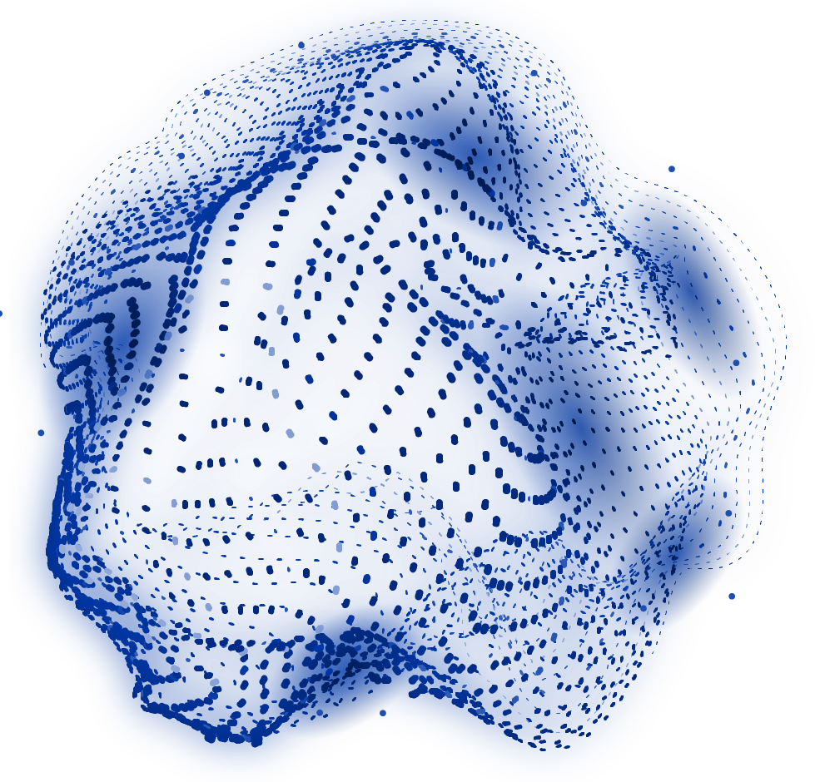
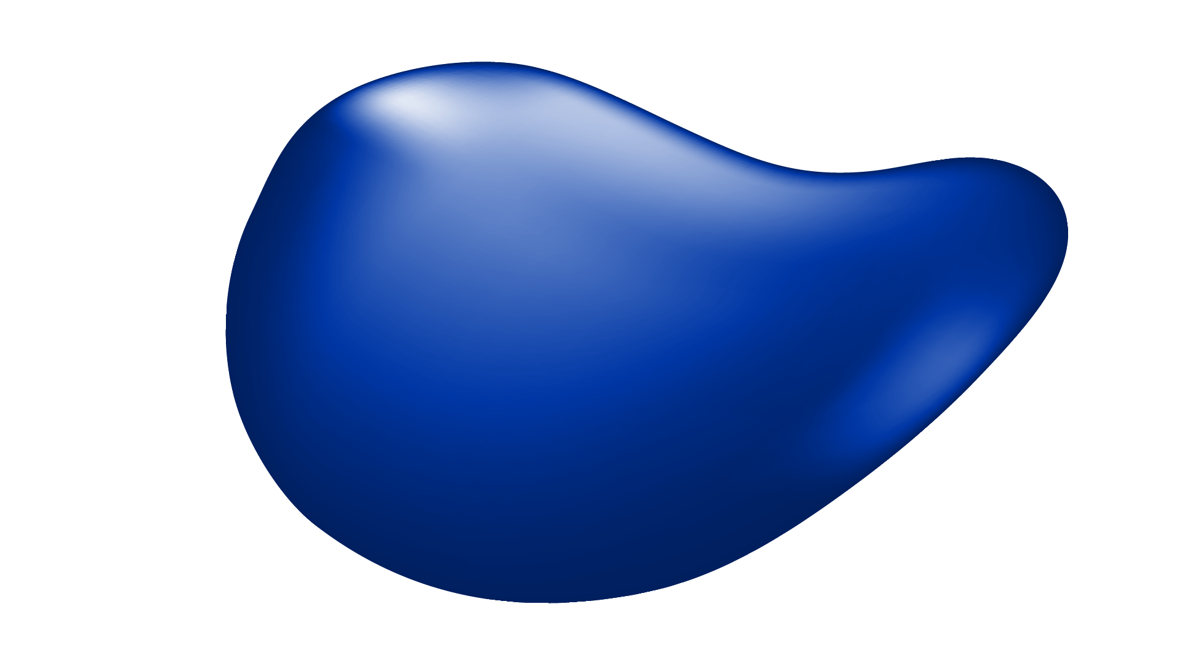
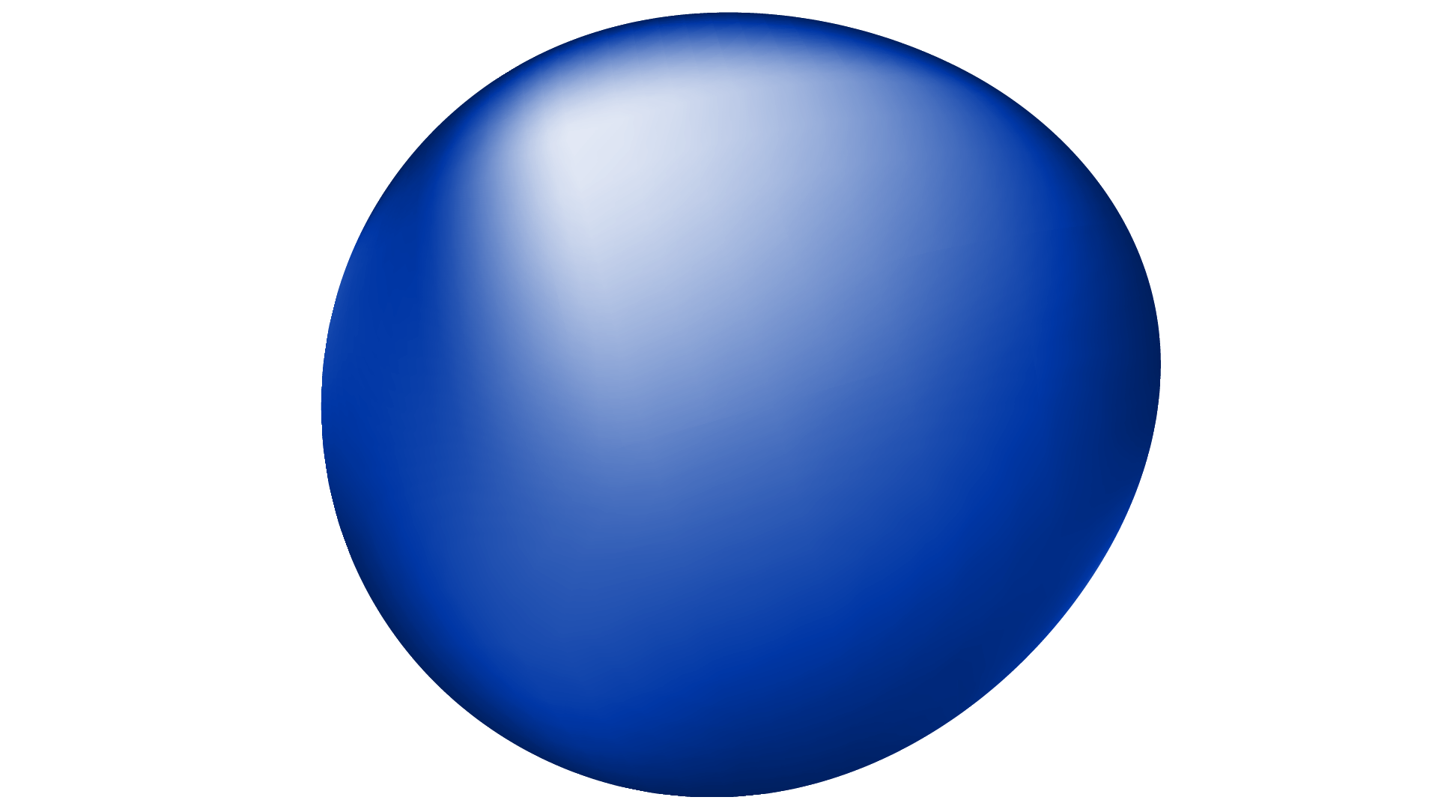
MultiModel ARTIFICIAL INTELLIGENCE (AI)
English Class
Presented By:
Abdelkarim DOUADJIA
Eness SEBBAR
Level of eduction : Master 1 Computer Science

Slide 2

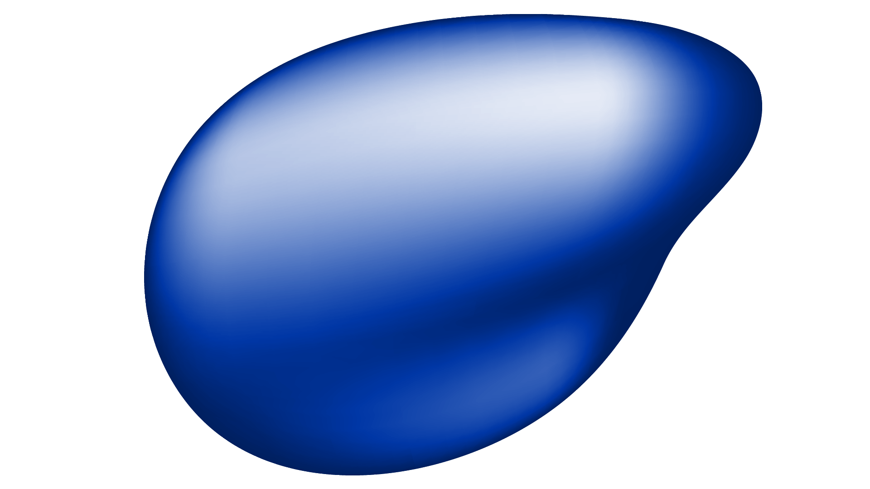
Presented By
DOUADJIA
ABDELKARIM
SEBBAR
ENESS
Master 1 AMIS
Master 1 IRS

Slide 3
TABLE OF CONTENTS
01
02
03
04
05
What is Multimodal AI?
Why Multimodal AI?
Key Components of Multimodal AI
Applications of Multimodal AI
Popular Multimodal Models

Slide 4
TABLE OF CONTENTS
07
08
09
10
06
Challenges in Multimodal AI
Sign Language Recognition: A Multimodal AI Application
Project Overview
Demo
Conclusion

Slide 5
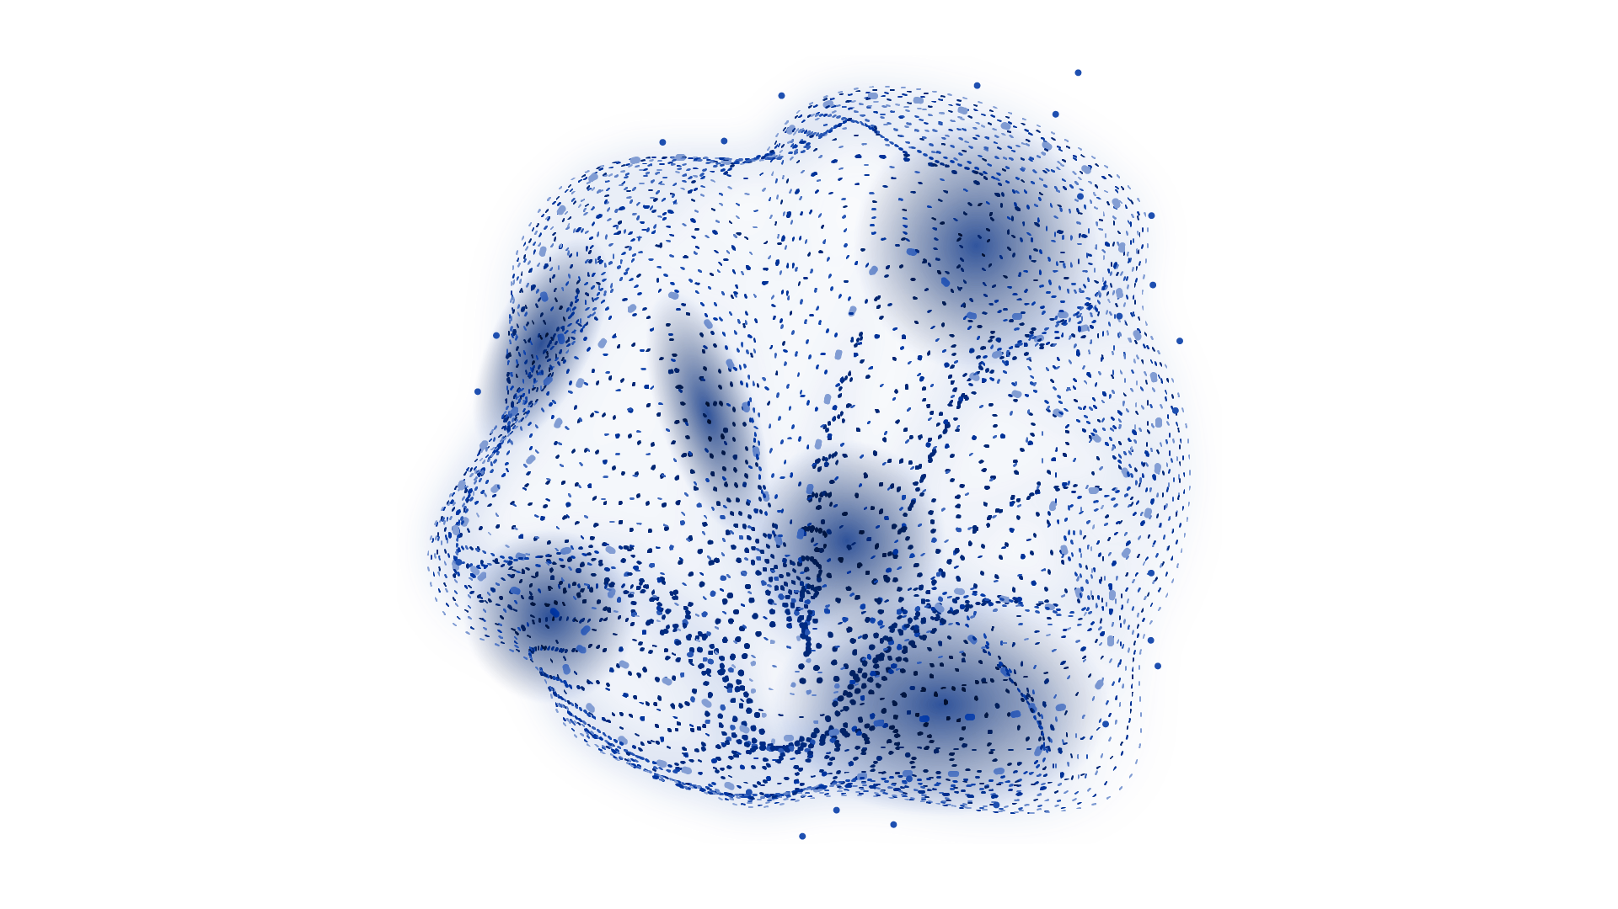
01
What is Multimodal AI?

Slide 6
What is Multimodal AI?
Definition: Multimodal AI integrates data from multiple modalities (e.g., text, images, audio, video) to achieve a task.
Key Idea: It combines the strengths of different types of data to create smarter, more capable systems.
Why It Matters:
Single sources of data can be limited or incomplete. Multimodal AI fills in the gaps.
It provides richer insights by understanding how different data types relate to each other.
Examples:
Text + Images: Generating captions for pictures.
Audio + Video: Recognizing speech with lip-reading support.
Sensors + Visuals: Combining LIDAR and camera feeds for autonomous cars.

Slide 7
02
Why Multimodal AI?

Slide 8
Why Multimodal AI?
Enhanced Understanding: By using different data types together, it captures more complete information about the world.
Improved Reliability: If one data type is unclear or noisy, the others can fill in the blanks.
Real-Life Applications: Many challenges in AI, like speech translation or gesture recognition, require more than one type of input.
Richer Interactions: Systems like virtual assistants become more interactive by using both speech and facial cues.
Examples in Action:
Healthcare: Combining medical history with imaging for better diagnostics.
Entertainment: Synchronizing character animation with voice input for realistic avatars.

Slide 9
03
Key Components of Multimodal AI

Slide 10
Key Components of Multimodal AI
1. Data Fusion:
Bringing together inputs from various sources to make sense of the full picture.
Example: Combining camera views and audio feeds in video conferencing tools.
2. Feature Representation:
Turning different types of data into machine-readable formats. For instance:
Images are processed by Convolutional Neural Networks (CNNs).
Text is encoded by Recurrent Neural Networks (RNNs) or Transformers.
3. Learning Architectures:
Models that process and align data from multiple modalities. Examples include attention-based networks and hybrid architectures.
4. Cross-Modality Interaction:
Aligning and connecting inputs, such as matching lip movement in videos to spoken words.

Slide 11
04
Applications of Multimodal AI

Slide 12
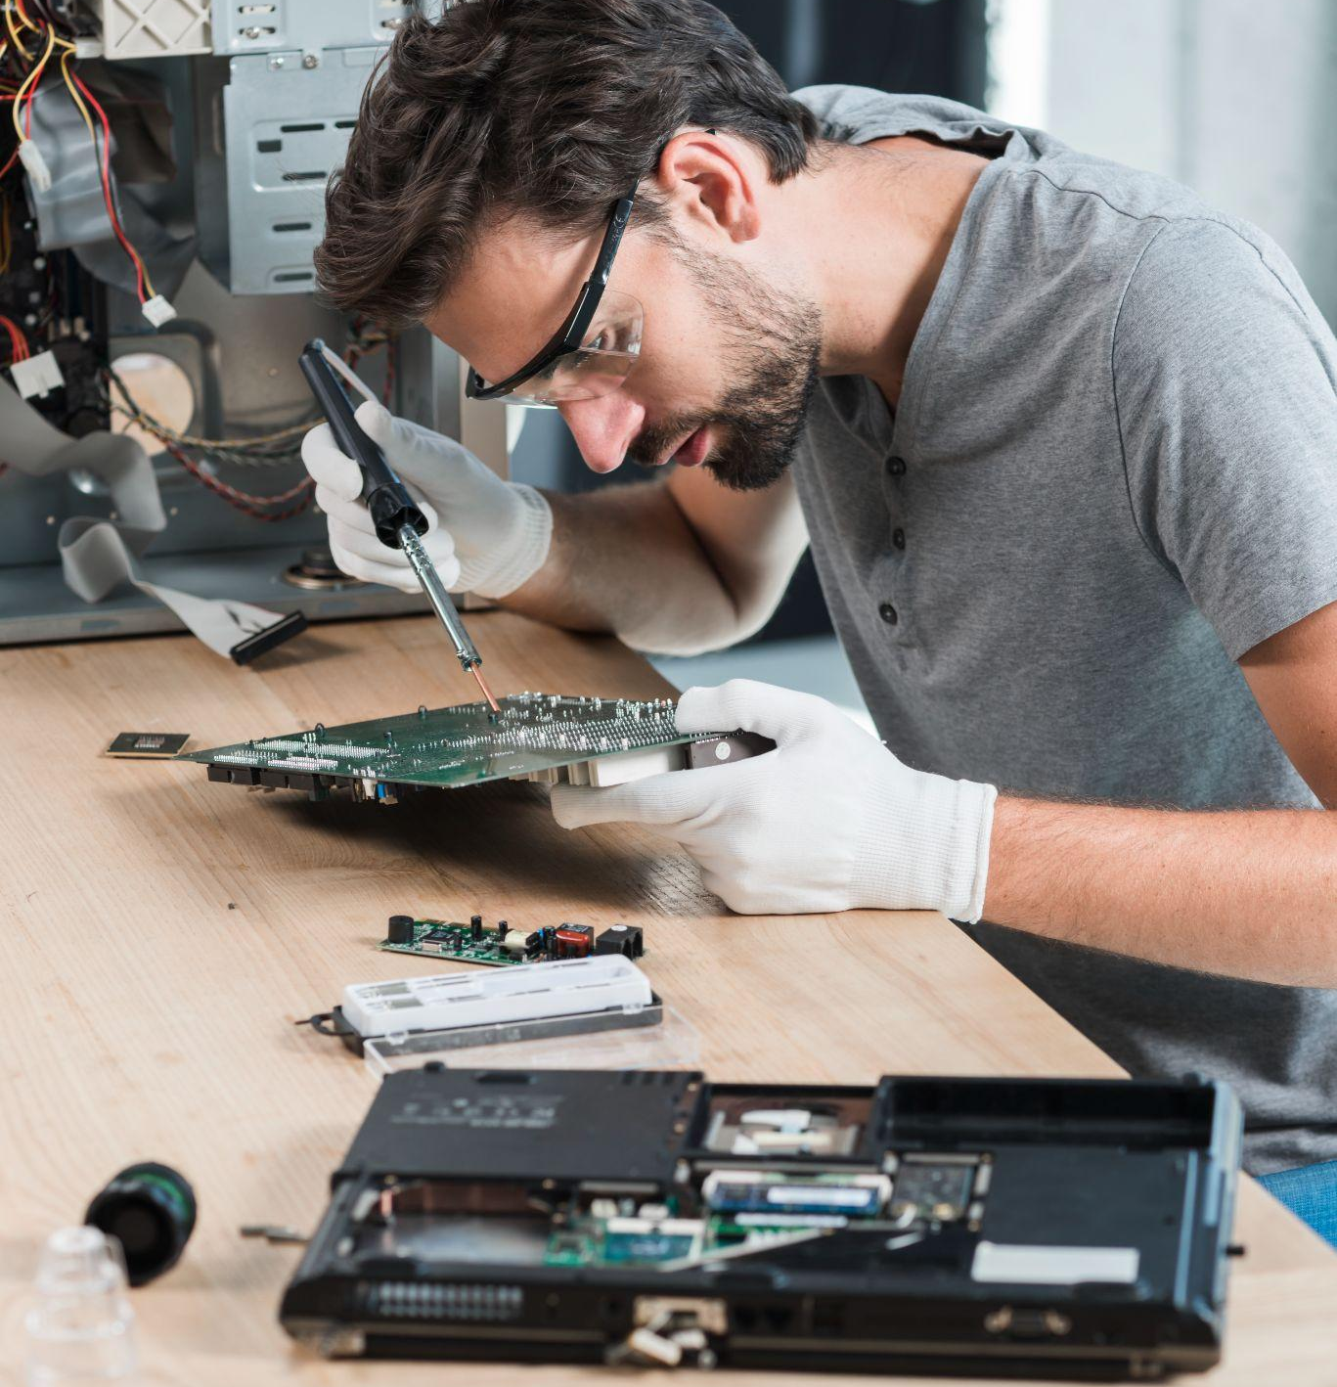
Applications of Multimodal AI
1. Healthcare:
Using CT scans, patient records, and lab results for diagnosing diseases more accurately.
AI systems that can combine these sources are helping detect conditions like cancer earlier.
Accessibility:
Translating spoken words into sign language using video and audio.
Assisting visually impaired users by describing images or surroundings.

Slide 13
Applications of Multimodal AI
Entertainment:
Generating lip-synced animations for gaming and virtual reality.
Combining soundtracks and visuals for improved storytelling.
4. Autonomous Vehicles:
Fusing GPS, LIDAR, and camera data to navigate safely.
5. Artificial Evolution (Husbands et al., 1997):
Virtual assistants that understand gestures alongside spoken commands.

Slide 14
05
Popular Multimodal Models

Slide 15
Popular Multimodal Models
These are some well-known multimodal AIs (they can work with text + images and sometimes audio/video):
OpenAI (GPT‑5.2): a strong general model used for writing, reasoning, coding, and can work with more than one input type (multimodal).
Google (Gemini 3.1 Pro): designed for advanced multimodal understanding — it can handle text, images, video, audio, and even code.
Anthropic (Claude — Opus/Sonnet 4.6): popular for reading and reasoning over documents and images (vision input).
If you want open / research-friendly options (often used in projects):
Meta (Llama 3.2 Vision): a vision‑language model you can run and adapt more easily than closed models.
Mistral (Pixtral Large): a multimodal vision‑language model with a long context window.
Qwen (Qwen2‑VL): a vision‑language model for image/video understanding.
A very common “helper” used inside multimodal systems:
CLIP / OpenCLIP: matches images with text (useful for search and retrieval).

Slide 16
06
Challenges in Multimodal AI

Slide 17
WHAT ARE WE WORKING ON?
Data Collection:
Complex Models:
Data Imbalance:
Gathering aligned and diverse
datasets can be expensive and
time-consuming.
Architectures that handle different data sources tend to be resource intensive.
One data source may have more examples than another, creating biases.

Slide 18
OUR ASPIRATIONS
Synchronization:
Interpretability:
Keeping modalities aligned in time and space can be tricky, especially in video and audio tasks.
Understanding why a model made a decision becomes harder when using complex, multimodal inputs.

Slide 19
07
Sign Language Recognition: A Multimodal AI Application

Slide 20
Sign Language Recognition: A Multimodal AI Application Example
Objective: Recognize sign language by combining video and hand pose data.
Why Multimodal AI?
Multimodal AI involves using two or more data types to achieve a goal.
This project integrates:
Video Data: Captures overall motion, arm movements, and gestures essential for sign language.
Hand Pose Data: Provides precise details about finger positions and hand shapes by detecting landmarks like joints.
Impact:
Improves communication tools for people who are hearing-impaired.
Builds systems that bridge language gaps and promote inclusivity.
Real-World Potential:
Making real-time sign-to-speech translation possible.
Helping students and educators in sign language learning environments.

Slide 21
08
Project Overview

Slide 22

Sign Language Recognition: A Multimodal AI Application Example
Project Title: "Multimodal AI for Sign Language Recognition (Video + Hand Pose Estimation)"
Goal: Build a system that can recognize sign language using multimodal data.
Modalities Used:
Video Data:
Captures the dynamic movements of hands and arms.
Hand Pose Data:
Tracks key hand landmarks, like finger joints, for detailed recognition.
Potential Applications:
Accessibility: real-time sign → text (and later sign → speech) for smoother communication.
Learning & practice: instant feedback (top‑3 guesses + stability ring) helps learners improve consistency.

Slide 23
09
Demo Version

Slide 24
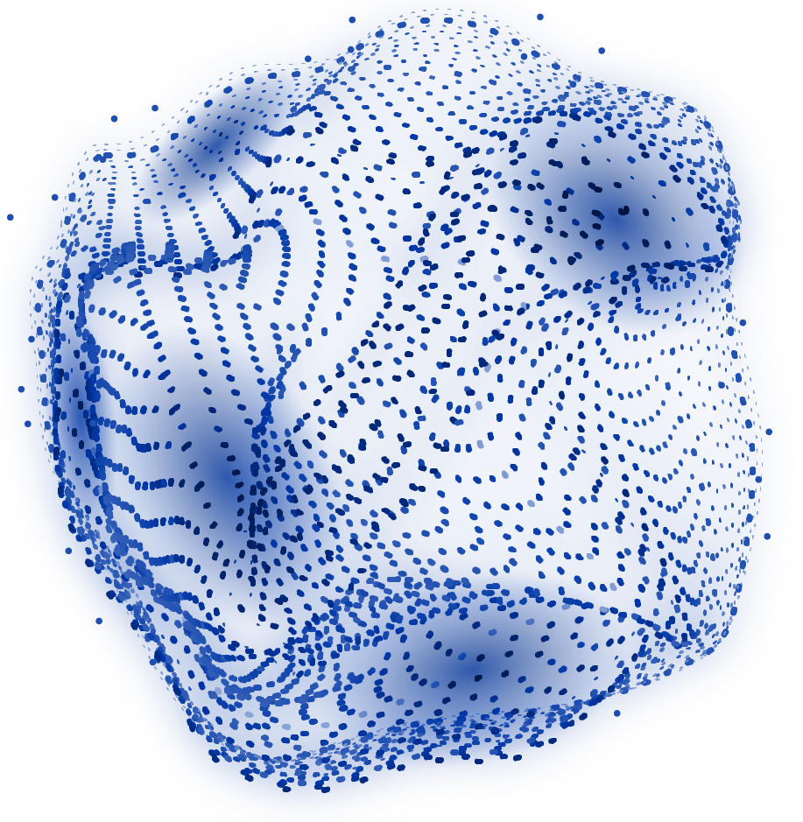
LIVE Demonstration

Slide 25
09
Conclusion

Slide 26
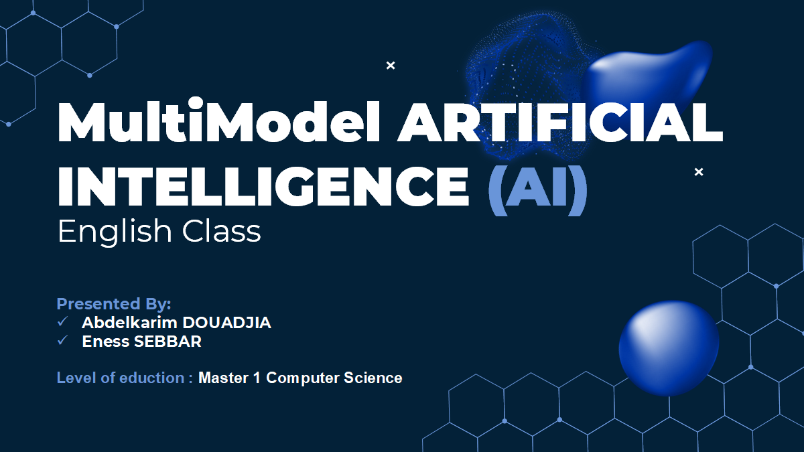
Conclusion
Summary:
Multimodal AI combines different types of data to create smarter and more capable systems.
Sign Language Recognition is a great example of how this technology can make a meaningful impact on accessibility.

Slide 27
Questions & Discussion

Slide 28
THANKS!
DO YOU HAVE ANY QUESTIONS?

